Slide 1
Representative Color Transform for Image Enhancement
Hanul Kim, Su-Min Choi, Chang-Su Kim, Yeong Jun Koh
Seoul National University of Science and Technology
Chungnam National University
Korea University
110354016 統計碩二 蔡耀德
110354025 統計碩二 林映孝
110354032 統計碩二 徐偉鑫

Slide 2
Abstract
Recently, the encoder-decoder and intensity transformation approaches lead to impressive progress in image enhancement.
The encoder-decoder often loses details in input images during down-sampling and up-sampling processes.
The intensity transformation has a limited capacity to cover color transformation between low-quality and high-quality images.
In this paper, the authors propose a new approach, called representative color transform (RCT), to solve these issues in existing methods.
RCT determines different representative colors specialized in input images and estimates transformed colors. It then determines enhanced colors using these transformed colors based on the similarity between input and representative colors.
Extensive experiments demonstrate that the proposed algorithm outperforms recent state-of-the-art algorithms on various image enhancement problems.

Slide 3
Introduction - Background
Nowadays, many people take photographs to record and share their valuable moments.
Unfortunately, their photographs often have low dynamic ranges or distorted color tones due to inadequate lighting conditions.
Therefore, image enhancement becomes popular to improve the visual aesthetics of these photos. For image enhancement, many attempts have been proposed, and considerable progress has been made.

Slide 4
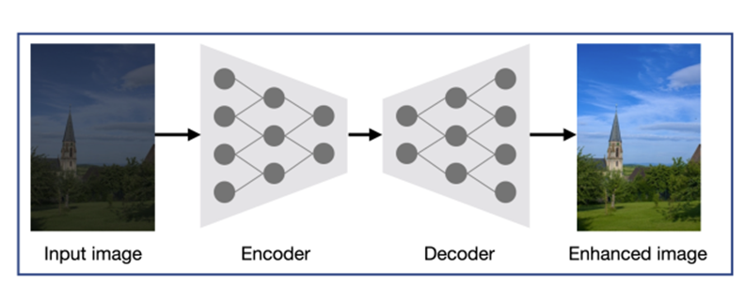
Introduction - Encoder-Decoder Architecture
Some studies based on the encoder-decoder architecture provide promising results by learning a robust non-linear mapping from large amounts of images.
The encoder extracts features from the input image to exploit the high-level context information and the decoder conveys the high-level information to low-level pixel values while recovering the spatial information.

Slide 5
Introduction - Some limitations
But encoder-decoder-based methods have some limitations.
First, details of the input image are not preserved in the up-sampling process of the decoder.
Second, these approaches train networks with fixed input size, which makes it difficult to enhance images of arbitrary spatial resolutions in the inference phase.
To overcome these issues, some methods estimate transformation functions to enhance images globally.

Slide 6
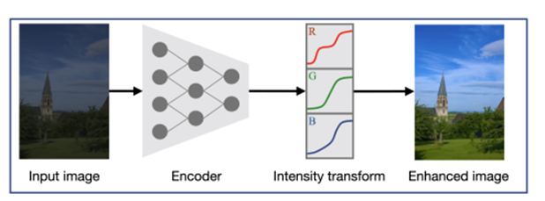
Introduction - Global-based Methods
Images can be enhanced while preserving details since these global enhancement methods do not require the down-sampling and up-sampling processes.
However, the existing global methods rely on intensity transformation functions on specific color space e.g. RGB or CIELab, pre-defined lookup tables, and enhancement operations.
Also, they perform channelwise color transformation and thus fail to consider all channels simultaneously. These pre-defined models have the limited capacity to cover color transformation between low-quality and high-quality images.

Slide 7
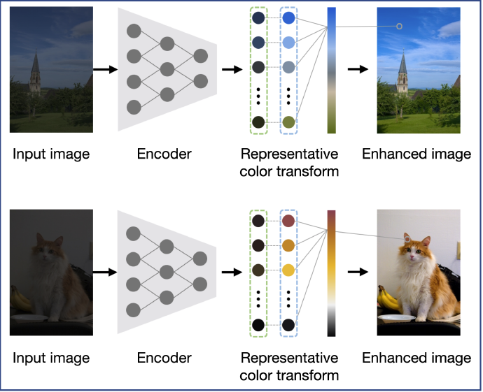
Introduction - RCT method
This paper proposed a enhancement approach, called Representative Color Transform(RCT).
Advantage:
A large capacity to cover the color transformation.
RCT can enhance an input image of the arbitrary size without any image resizing.
(That is, preventing performance degradation due to artifacts, such as blur, caused by the resize of enhanced images.)

Slide 8
Introduction - RCT method
Based on the proposed RCT, we propose a representative color transform network (RCTNet), which consists of 4 modules: encoder, feature fusion, global RCT, and local RCT.
Step1: Encoding the input image to extract the high-level context information for image enhancement.
Step2: Using the high-level context to determine representative colors for the input image and estimate transformed colors for the representative colors.
Step3: Computing the similarity between the input image and the representative colors in an embedding space.
Step4: Developing a representative color transform to obtain the enhanced image by combining the similarity and the representative color transformation.

Slide 9
Related work
Early studies on image enhancement improve the global contrast of an input image. For instance, power-law (gamma) and logarithmic transformation, histogram equalization.
Recent image enhancement methods mainly focus on learning mapping functions between low-quality and highquality images based on data-driven approaches.
Yan et al. and Lore et al. propose methods which are based on neural networks with small receptive fields, and their models may be insufficient to exploit high-level contexts for image enhancement.
Chen et al., Gharbi et al., Wang et al., Xu et al., Yang et al. propose methods which are based on the encoder-decoder approach, the encoder incrementally increases the size of receptive fields. But these encoder-decoder architectures do not preserved details of input images in down-sampling and upsampling processes.

Slide 10
Related work
Some methods (Deng et al., Guo et al., Kim et al. Zeng et al.) perform global enhancement through transformation functions or pre-defined enhancement operations, these global-based methods enhance low-quality images without resize image.
But they have limitations in transformation functions on the pre-defined color space, lookup tables, or operations. It may not be sufficient to estimate highly non-linear mapping between low-quality and high-quality images.
In contrast, the proposed method estimates adaptive representative colors according to the input image, and predicts color transformation for each representative color based on the attention mechanism.

Slide 11
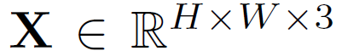

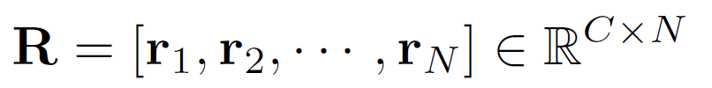
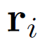
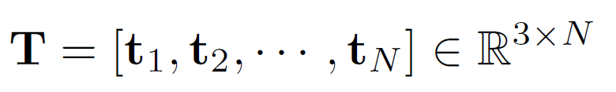
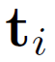
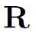
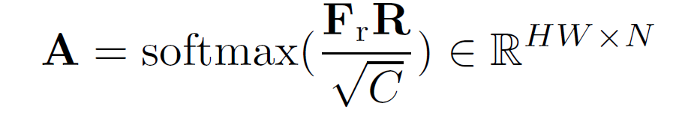
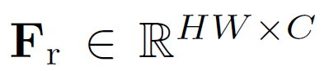

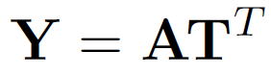
Proposed method – RCT
Input:
encode
Feature representation:
Extract features and transformed colors for N representative color
Let
as the set of representative features,
where ri denotes a feature vector of ith representative color and C is a feature dimension
Let
as the set of transformed colors,
where ri denotes a feature vector of ith representative color and it mapped by
Let attention matrix
where ri is from the input X using a stack of convolution layers
The enhanced image

Slide 12
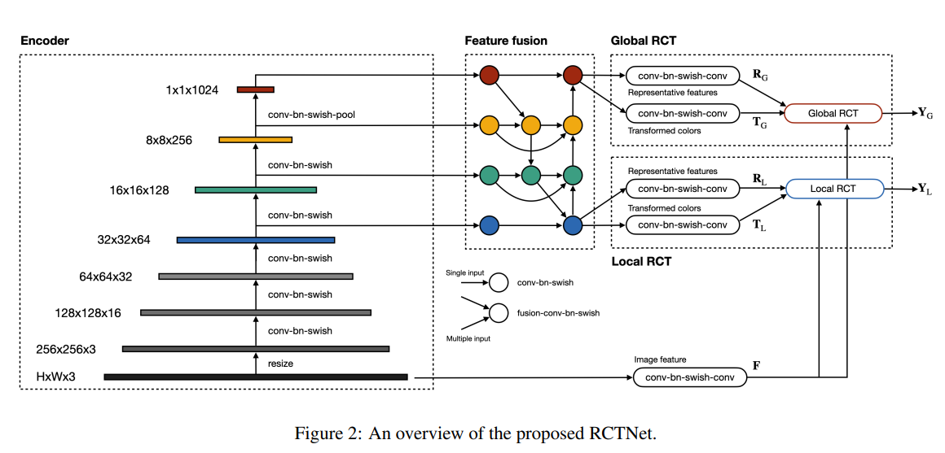
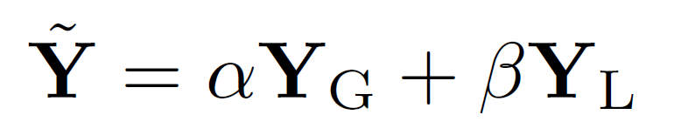
Proposed method – RCTNet Architecture
The final output image:

Slide 13
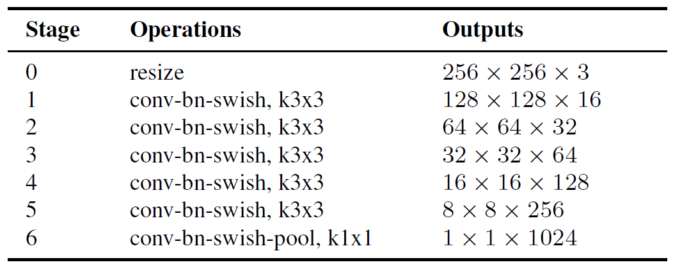
RCTNet Architecture - Part 1
Encoder
Feature Fusion
Coarse-scale feature map: general global information from deeper layer
Fine-scale feature map: detailed local information from upper layer
To construct the feature fusion module, employ the bidirectaional cross-scale connections
A convolutional neural network to extract the information for image enhancement
Each ‘conv-bn-swish’: convolution, batch normalization and swish activation
All convolution have 3 x 3 filters but last block uses a convolution layer with 1 x 1 filter

Slide 14
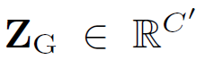
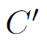
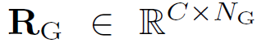
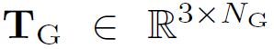
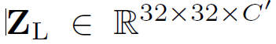
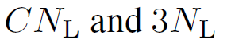
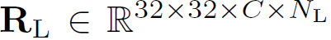
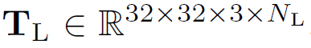
RCTNet Architecture - Part 2
Global RCT
Let ZG 2 RC0 denote an output feature from the coarsest-scale in the feature fusion module, where C0 is set to 128
Through two different ‘conv-bn-swish-conv’ blocks
Local RCT
Let ZG 2 RC 0 denote an output feature from the finest-scale in the feature fusion module
Through the first convolution layers have 128 convolution filters of size 3 x 3 and second convolution layer has CN and 3NL filters of size 3 x 3, respectively

Slide 15



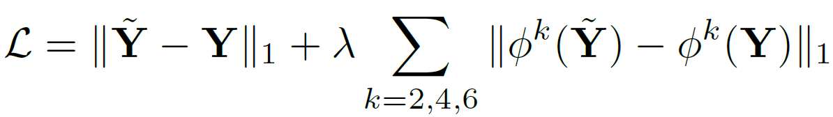
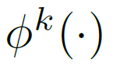
Proposed method – Loss Function
A pair (X,Y), where X and Y are an input low-quality image and its high-quality image, respectively
The loss function between Y and is:
The embedding function k() is the output of kth layer in VGG-16, which is pre-trained on the ImageNet dataset

Slide 16
Experiments - Datasets
MIT-Adobe 5K
Consists of 5,000 images, decompose it to 4,500 and 500 images for training and testing set.
Low Light (LoL)
500 pairs of low-light and normal-light images, separated into 485 training images and 15 testing images.
Enhancing Underwater Visual Perception (EUVP)
The paired dataset separates pairs of low-quality and high-quality images into 11435, 570, and 515 pairs for the training, validation, and test sets.
Underwater Image Enhancement Benchmark (UIEB)
890 pairs of underwater image and its enhanced image. 800 for training and 90 for testing image.

Slide 17
Experiments - MIT-Adobe 5K
Method | PSNR | SSIM
HDRNET | 23.44 | 0.882
DPE | 23.34 | 0.873
DUPE | 23.61 | 0.887
DLPF | 24.48 | 0.887
3DLUT | 25.21 | 0.922
GEN-LEN | 25.88 | 0.925
RCTNet | 26.02 | 0.915
RCTNet + BF | 26.07 | 0.923
Testing set performance (100 epochs with batch size of 8)

Slide 18
Experiments - Low Light (LoL)
Method | PSNR | SSIM
NPE | 16.97 | 0.589
LIME | 15.24 | 0.470
SRIE | 17.34 | 0.686
RRM | 17.34 | 0.686
SICE | 19.40 | 0.690
DRD | 16.77 | 0.559
KinD | 20.87 | 0.802
DRBN | 20.13 | 0.830
ZeroDCE* | 14.86 | 0.559
EnlightenGAN* | 15.34 | 0.528
RCTNet | 22.67 | 0.788
RCTNet + BF | 22.81 | 0.827
Testing set performance (500 epochs with batch size of 8)
* The methods are trained with unpaired images.

Slide 19
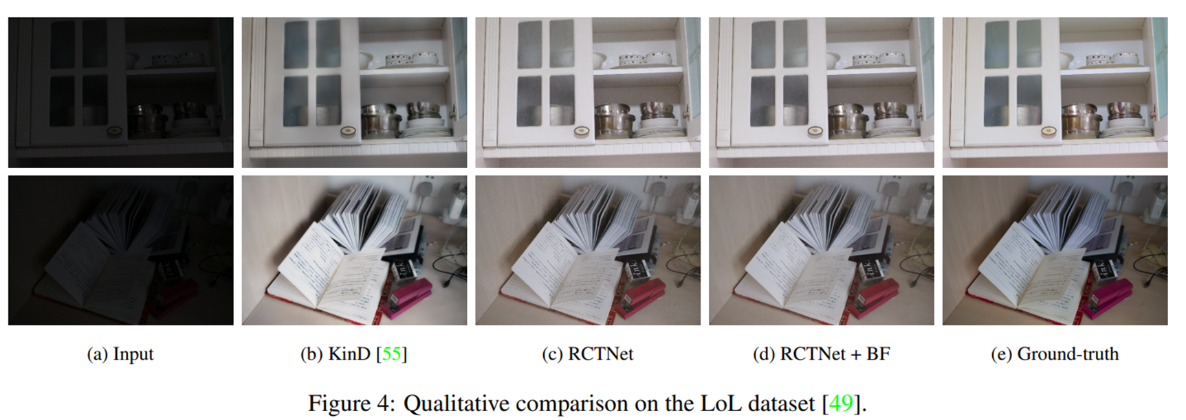
Experiments - Low Light (LoL)

Slide 20
Experiments - EUVP
Method | PSNR | SSIM
U - GAN | 23.49 | 0.842
Funie - GAN | 23.40 | 0.827
Deep SESR | 24.21 | 0.840
RCTNet | 26.43 | 0.915
Testing set performance (500 epochs with batch size of 8)

Slide 21
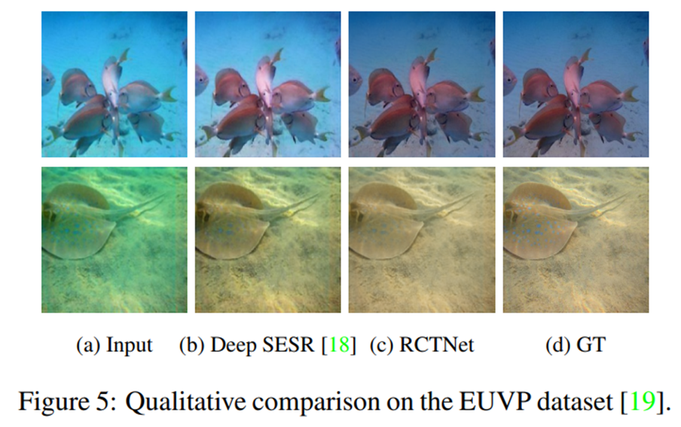
Experiments - EUVP

Slide 22
Experiments - UIEB
Method | PSNR | SSIM
Fushion | 17.60 | 0.772
Retinex | 17.02 | 0.607
GDCP | 12.09 | 0.512
Histogram | 15.82 | 0.539
Bluriness | 15.32 | 0.603
Water CycleGAN | 15.75 | 0.521
Dense GAN | 17.28 | 0.443
WaterNet | 19.11 | 0.797
Ucolor | 20.63 | 0.770
RCTNet | 22.45 | 0.891
Testing set performance (100 epochs with batch size of 8)

Slide 23
Experiments – Low Light (LoL)
We imple RCTNet on training sets with 20 epochs and 500 epochs.
Method | PSNR | SSIM
RCTNet - 20 epochs | 16.05 | 0.599
RCTNet - 500 epochs | 19.96 | 0.768
RCTNet - Paper | 22.67 | 0.788

Slide 24
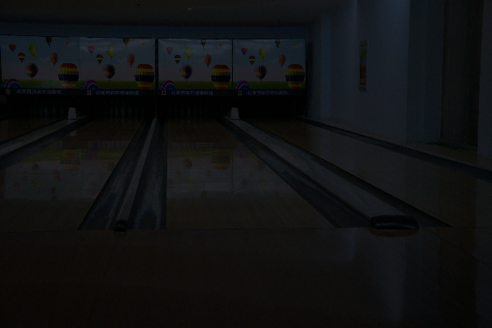
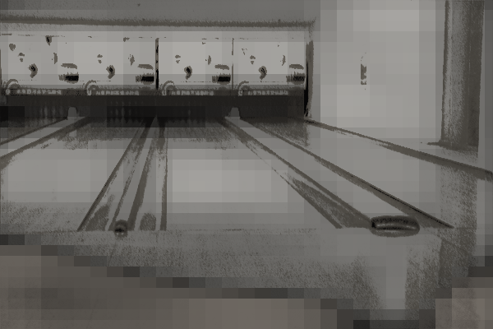
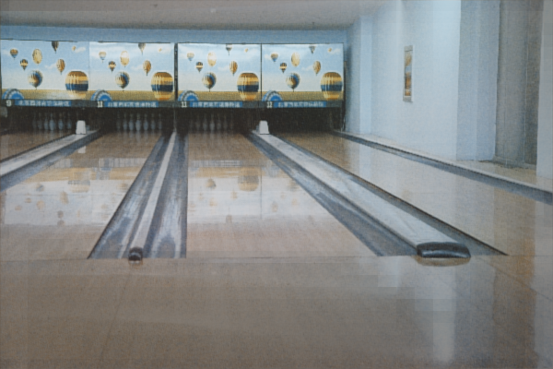
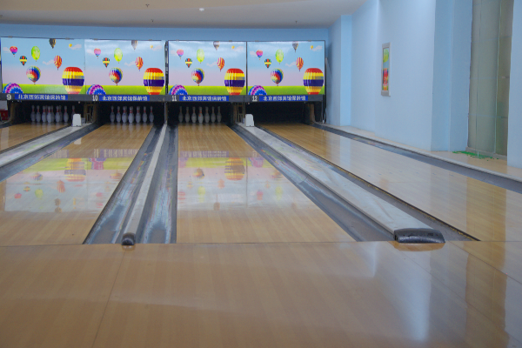
Experiments - LoL testing image (No.669)
low-light
20 epochs
500 epochs
normal-light

Slide 25

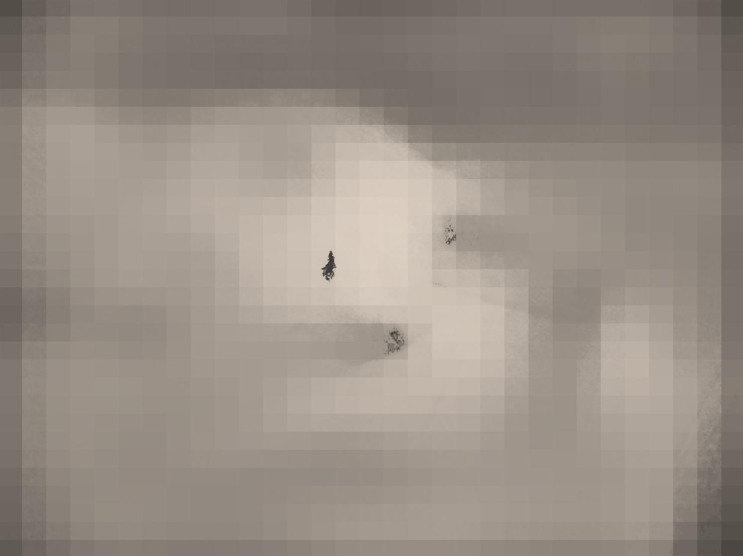
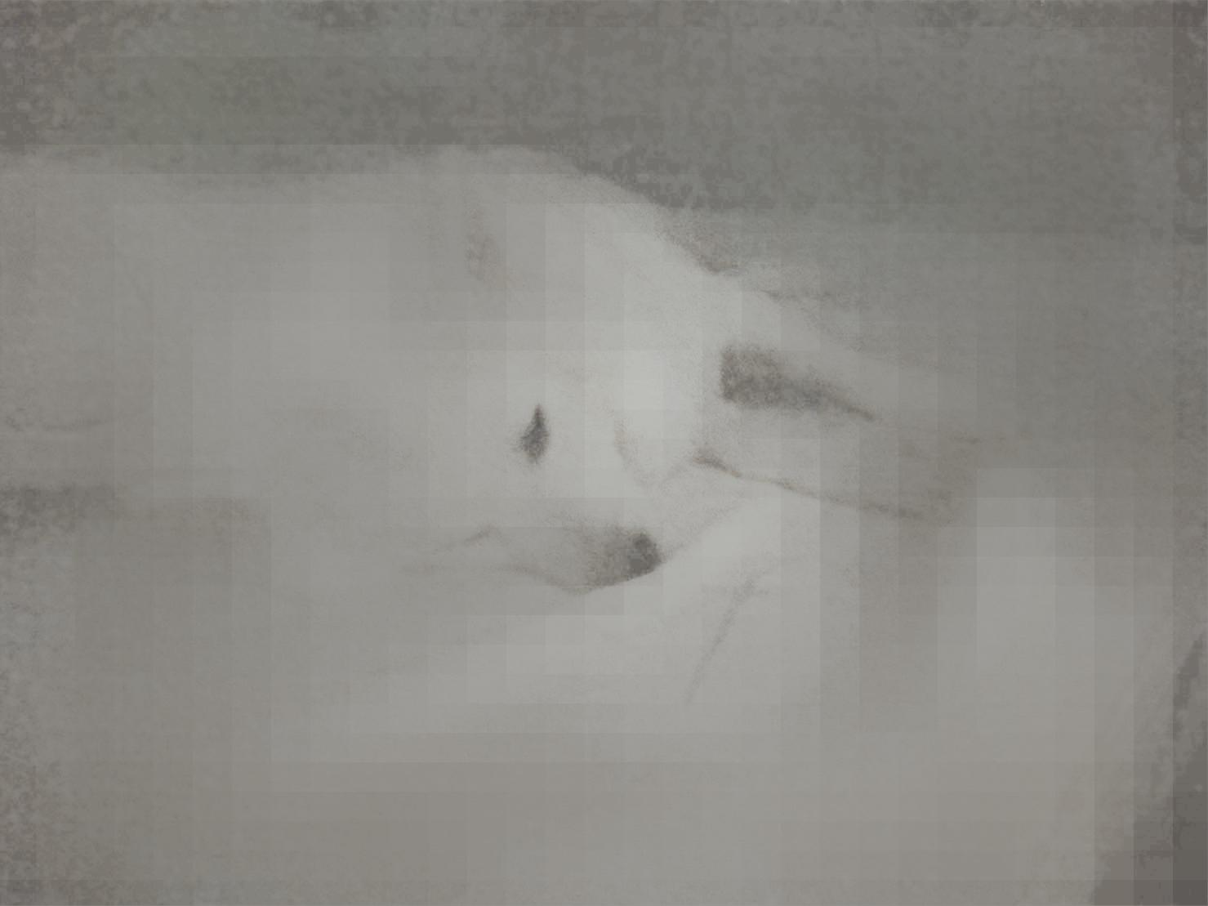

Experiments - 毛毛 image
low-light
20 epochs
500 epochs
normal-light

Slide 26
Conclusion
RCT determines different representative colors specialized in input images and enhances input images using representative features and transformed colors. Composed of encoder, feature fusion, global RCT, and local RCT modules.
The global RCT predicts representative colors for an input image, while the local RCT considers local region characteristics for image enhancement.
RCTNet outperforms recent state-of-the-art algorithms on various datasets with standard image enhancement, low-light image enhancement, and underwater image enhancement.

Slide 27
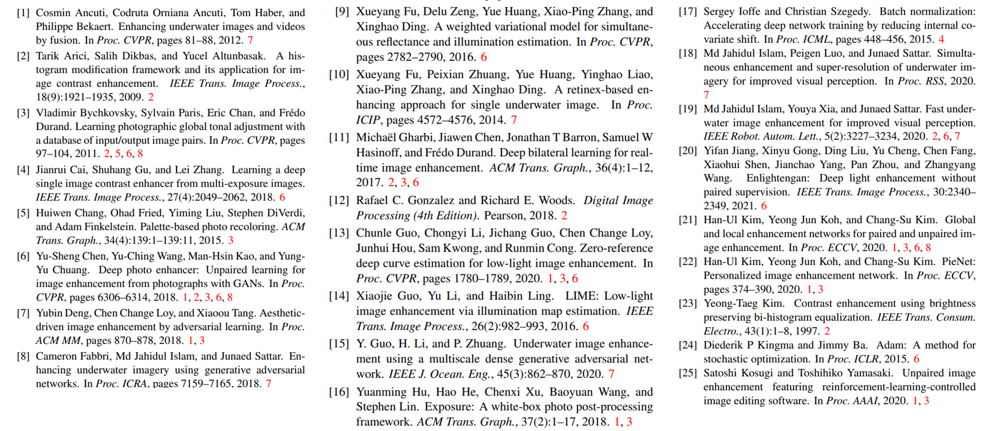
Reference

Slide 28
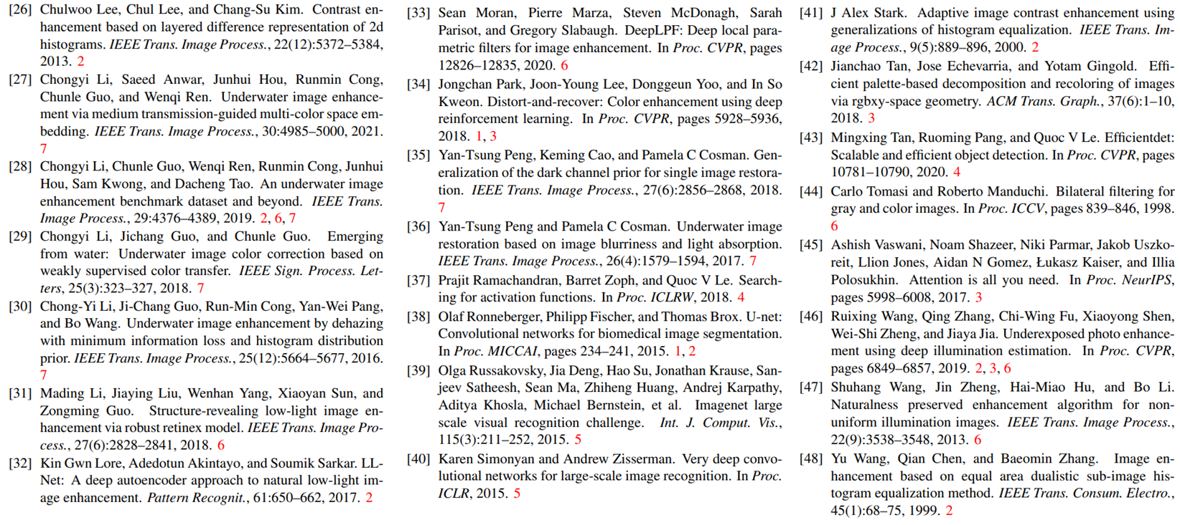
Reference

Slide 29
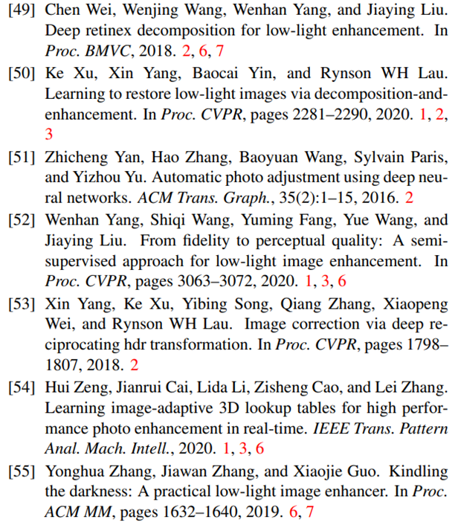
Reference

